Slide 1
Soil Physics
Silvio Gumiere

Slide 2
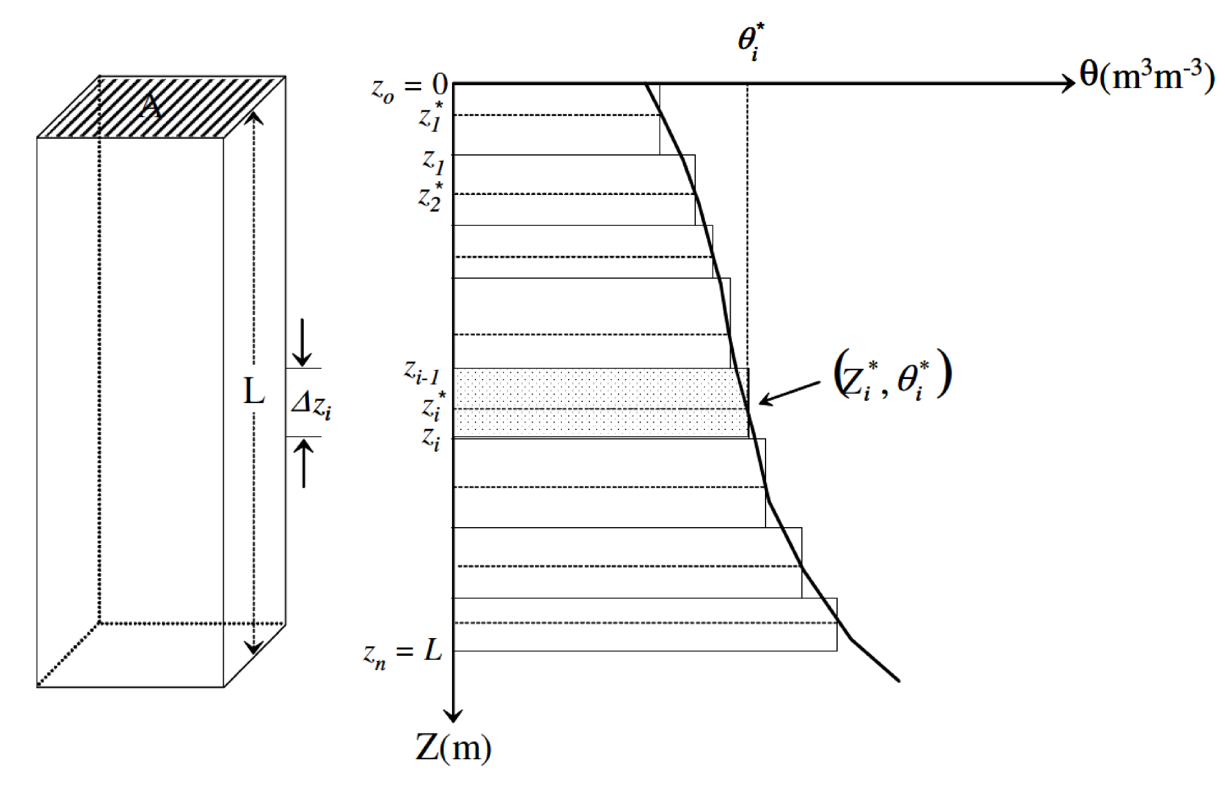
Water content

Slide 3
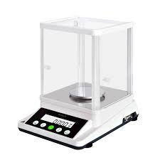
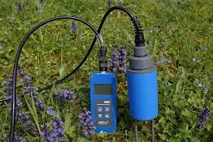
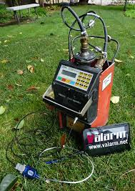
Measuring water content (presentation)
Gravimetric
TDR
n-Probe

Slide 4
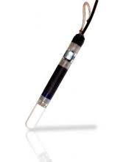
Soil water potential

Slide 5
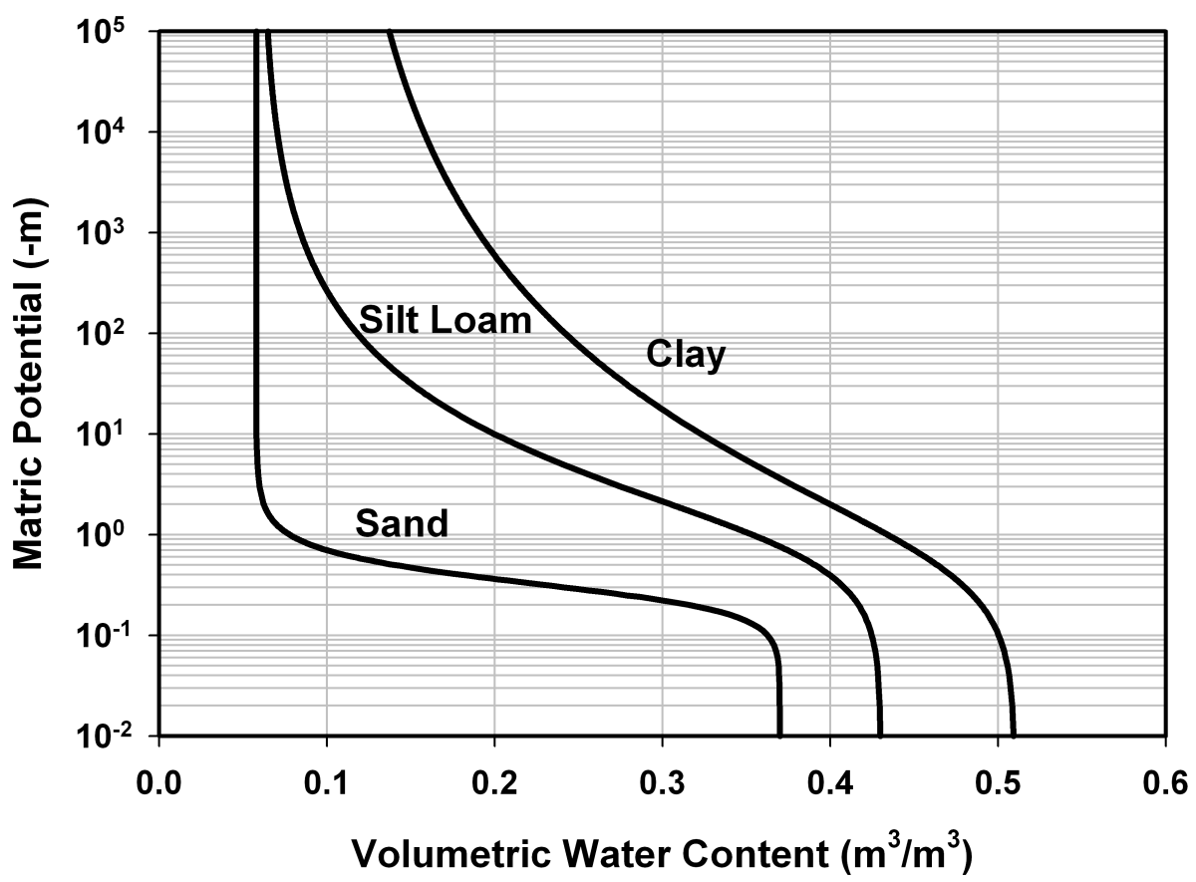
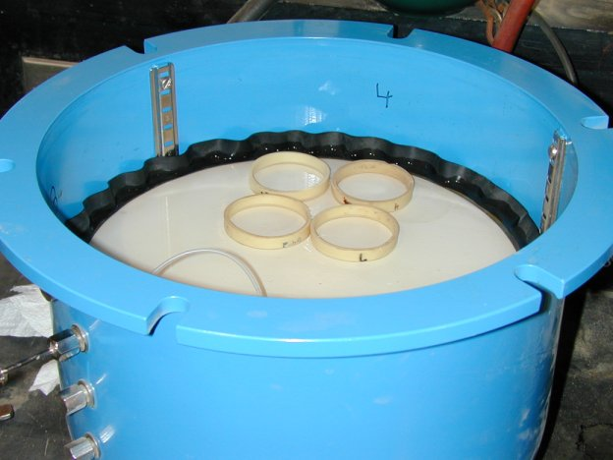
The Soil Water Characteristic - Introduction and Measurement

Slide 6
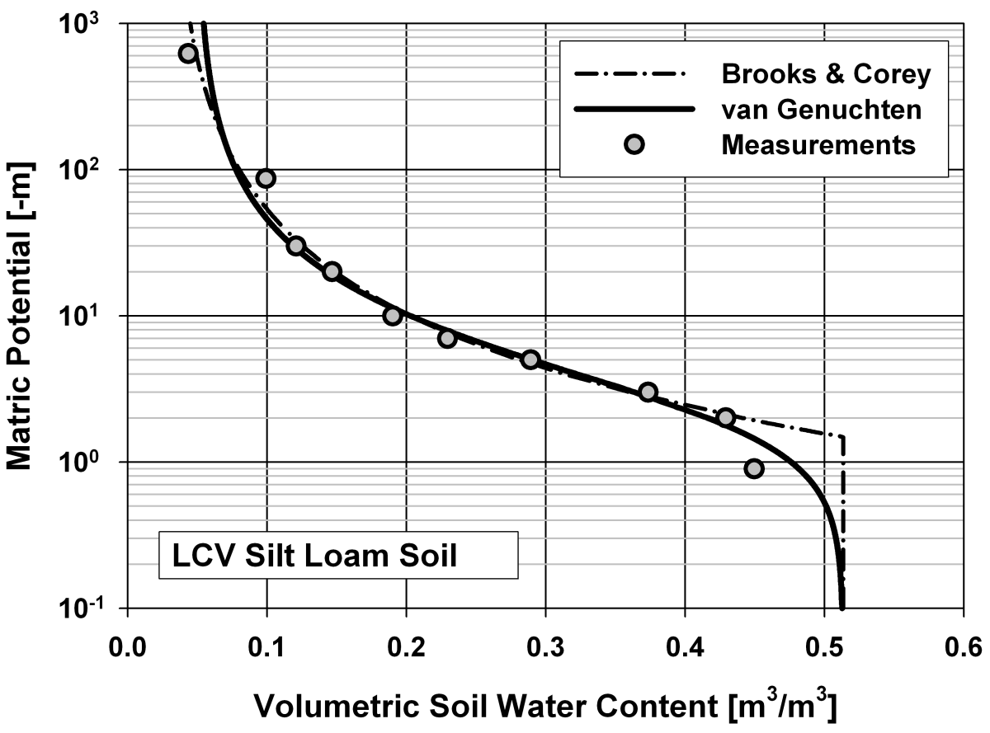
The Soil Water Characteristic Curve
The Soil Water Characteristic (SWC) curve describes the functional relationships between soil water content (θ_{v} or θ_{m}) and matric potential under equilibrium conditions.
The SWC is an important soil property related to pore space distribution (sizes, interconnectedness), which is strongly affected by texture and structure and related factors including organic matter.
The SWC is a primary hydraulic property required for modeling water flow in porous materials.
The SWC function is highly nonlinear and relatively difficult to obtain accurately.

Slide 7
The Soil Water Characteristic Curve
Typical soil water characteristic curves for soils of different texture

Slide 8
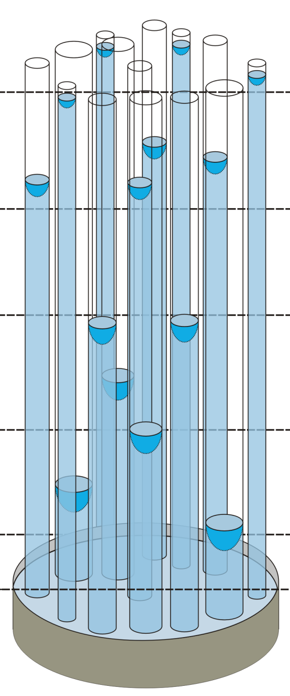
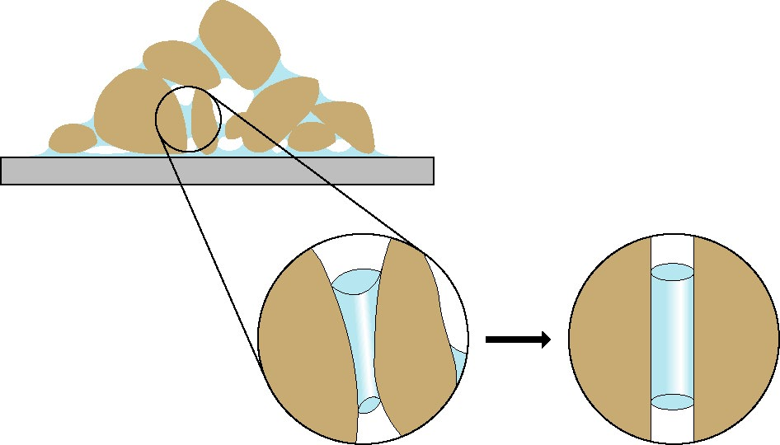
The Soil Water Characteristic Curve
Early conceptual models for SWC curve were based on the "bundle of cylindrical capillaries" (BCC) representation of pore space geometry (Millington and Quirk, 1961).
The BCC representation postulates that at a given matric potential a portion of interconnected cylindrical pores is completely liquid filled, whereas larger pores are completely empty.
Soil sample
actual
pore
equivalent
capillary

Slide 9
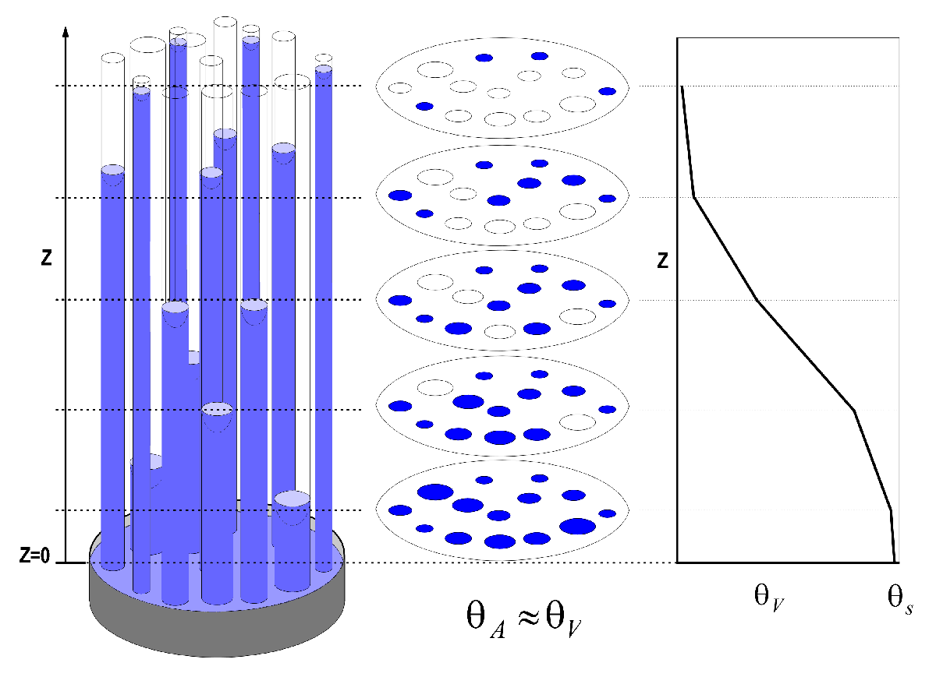
The Soil Water Characteristic Curve
This convenient idealization of soil pore space enables a linkage between the soil pore size distribution and the SWC based on capillary rise equation

Slide 10
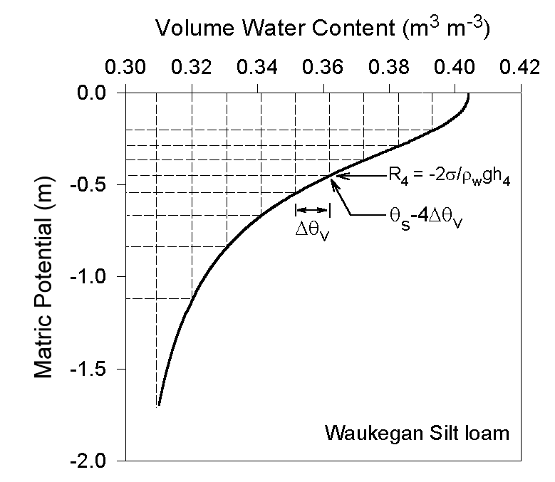
Using SWC to determine pore size distribution
The total saturation water contend θ_{s} is divided into a certain number M of equal increments Δθ_{v} where the matric potential h_{j} corresponds to a water content of θ_{s}- jxΔθ_{v}
We assume that all tubes with radii greater than R_{j} have drained at matric potential h_{j}

Slide 11
Using SWC to determine pore size distribution
The number of capillaries having a radius R_{j} per unit area in each water content interval is: n_{j}=Δθ_{v}/πR_{j}² (where Δθ_{v} is interpreted as the fraction of the water-filled cross sectional area that is reduced when all capillaries having a radius of R_{j} drain).

Slide 12
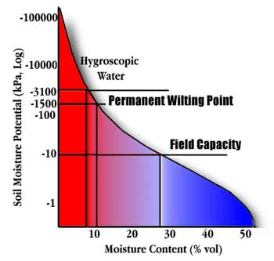
SWC and Plant Available Soil Revisited
The concept of Field Capacity and Wilting Point discussed in the previous section on water content have a more quantitative definition in terms of potentials and SWC.
Field Capacity - water content @ 1/3 bar (for sandy soils 0.1 bar)
Wilting Point – water content @ -15 bars

Slide 13
Measurement Methods for SWC
The basic requirement is to find pairs of water content θ and matric potential ψ_{m} over the wetness range of interest.
Experimental Difficulties:
The limited functional range (-10 m) of tensiometers used for in-situ measurements.
Difficulty to obtain undisturbed samples for laboratory determination.
Very long equilibration times for low matric potential values associated with dry soils

Slide 14
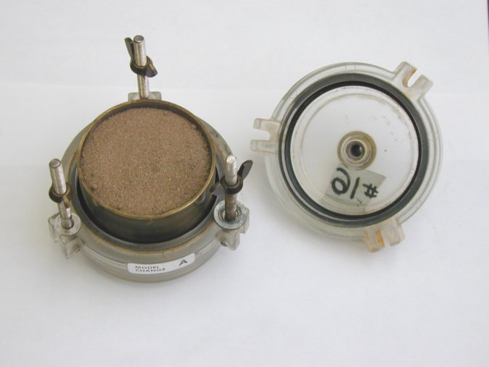
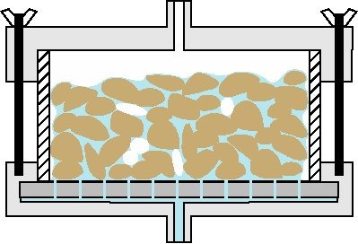
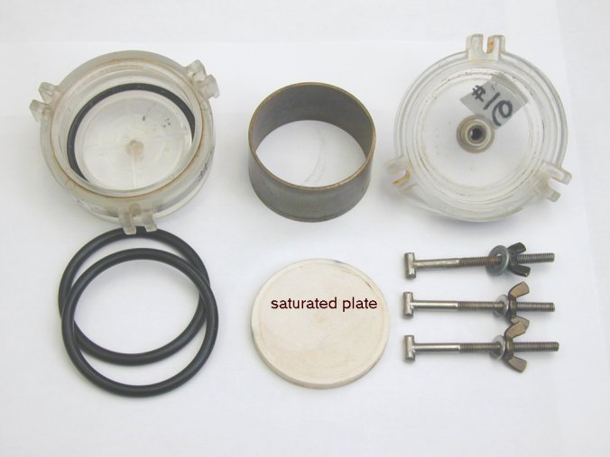
Tempe Cell
The pressure flow cell (Tempe cell) is usually applied for the pressure (matric potential) range from 0 to -10 m.
Gas Pressure
Brass Ring
Soil Sample
Ceramic Plate
Outflow
Close to saturation soil water retention is strongly influenced by soil structure and the natural pore size distribution. Therefore undisturbed core samples are preferred over repacked samples.

Slide 15
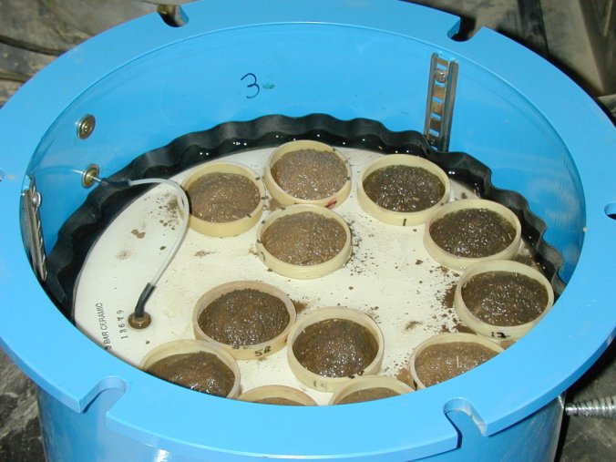
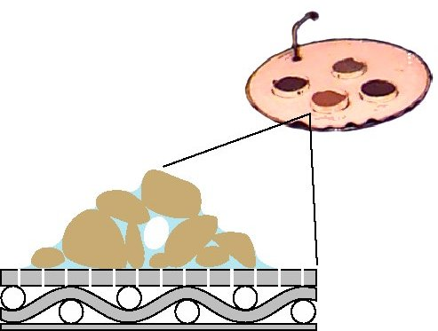
Pressure Plate Apparatus
The pressure plate apparatus is applied for the pressure (matric potential) range from -10 to -50 m.
Porous Plate with Samples
Soil Sample
Chamber Pressure
Atmospheric Pressure
Porous Plate

Slide 16
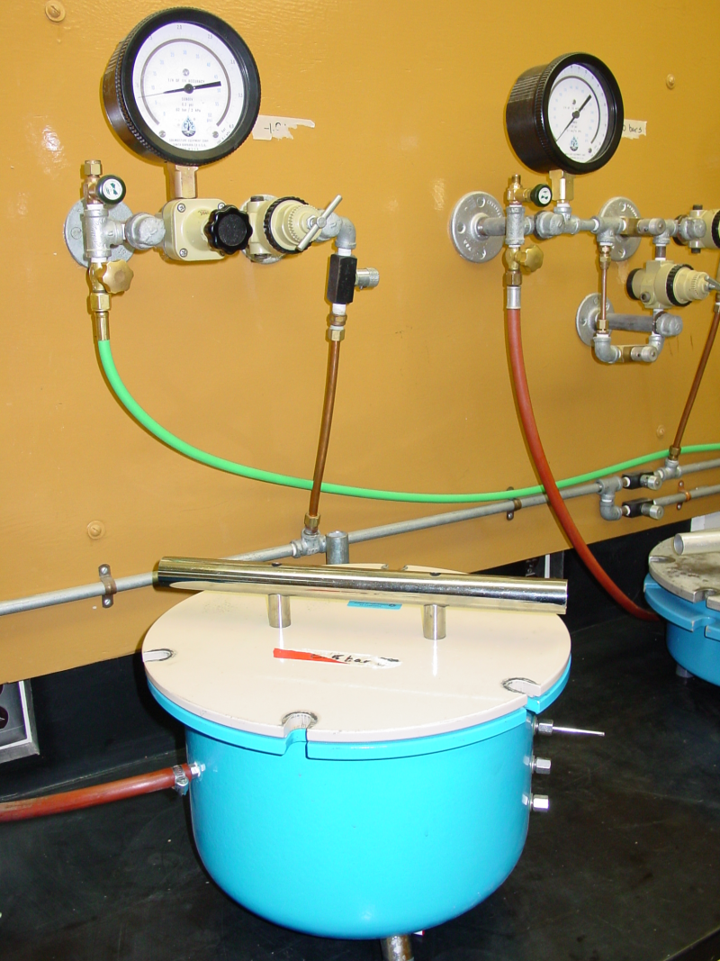
Pressure Plate Apparatus

Slide 17
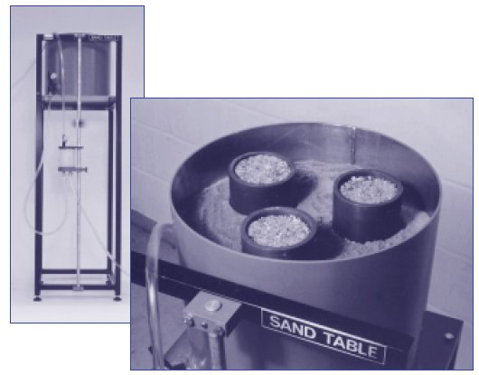
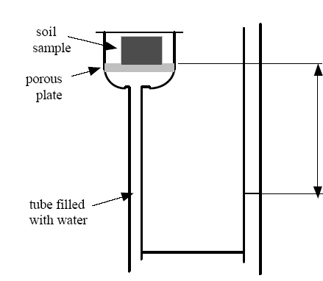
Hanging water column and suction table
Measurements at very low pressure ranges of 0 to 2 m.
Useful for coarse soils due to precise pressure application.
Wetting and drying cycles of the SWC (reversible flow into the sample).
Δh

Slide 18
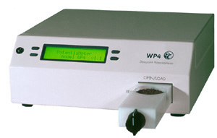
Vapor Pressure-Based Methods
A procedure inferring water potential using thermocouple psychrometers that is commonly used in newer instruments is called DEWPOINT METHOD
In this method one surface is brought to dew point temperature and kept at exactly this temperature using a monitoring system and electronic circuitry.
State of the art equipment (e.g., WP4 Potentiameter) uses chilled mirror dewpoint technique combined with a photoelectric detection system to keep the surface of a mirror at dewpoint temperature. Ambient temperature at the sample surface is measured with an infrared thermometer.
WP4 Potentiameter

Slide 19
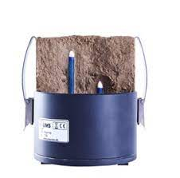
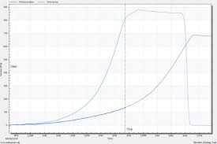
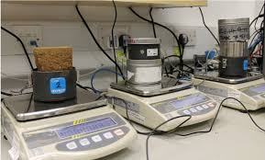
HYPROP

Slide 20

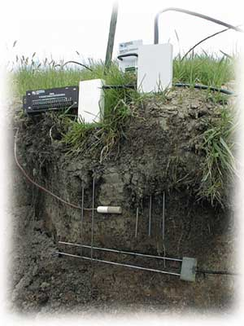
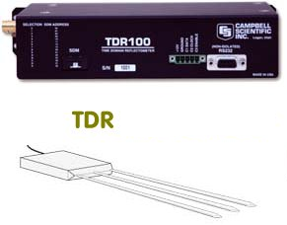
In-situ measurement methods – Sensor Pairing
SENSOR PAIRING: (TDR, Neutron Probe, Tensiometer, Heat Dissipation, etc)
Example - TDR Probes installed in close proximity to transducer-equipped tensiometers are commonly used for automated recording of changes of water content and matric potential with time.
IN-SITU MEASUREMENTS ARE CONSIDERED MOST REPRESENTATIVE.

Slide 21
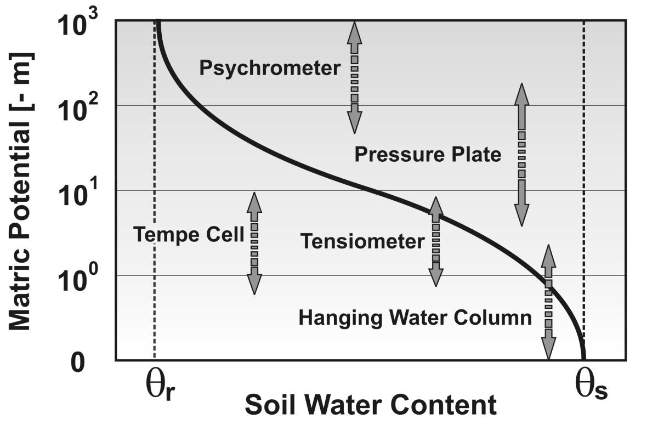
SWC measurement ranges

Slide 22
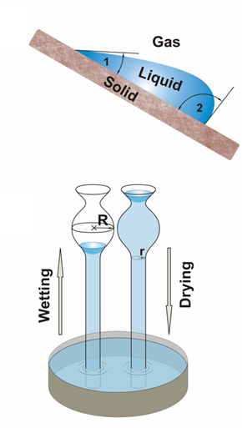
The Soil Water Characteristic - Parametric Models and Hysteresis

Slide 23
Parametric SWC Models
Measuring a SWC is laborious and time consuming. Usually there are only a few data pairs available from measurements.
For modeling and analysis (characterization and comparison of different soils) it is beneficial to represent the SWC relationship as continues parametric function.
Commonly used parametric models are the van Genuchten and Brooks & Corey relationships.
Van Genuchten Model (1980):
The unknown parameters (free parameters) α, n, and θ_{r} can be obtained by fitting the model to a few (at least 5-8) measured data pairs (Nonlinear regression with 0 ≤ m ≤ 1, and θ_{r} ≥ 0).

Slide 24
Parametric SWC Models
Brooks and Corey Model (1964):
The unknown parameters (free parameters) ψ_{b}, θ_{r},and λ can be obtained by fitting the model to measured data pairs
In both models MATRIC POTENTIALS are expressed as positive (absolute) quantities.
There are various computer codes available (e.g., RETC) for estimation of free model parameters. A simple procedure is the application of solver tools that are part of most spreadsheet software packages.

Slide 25
Van Genuchten and Brooks & Corey Models

Slide 26
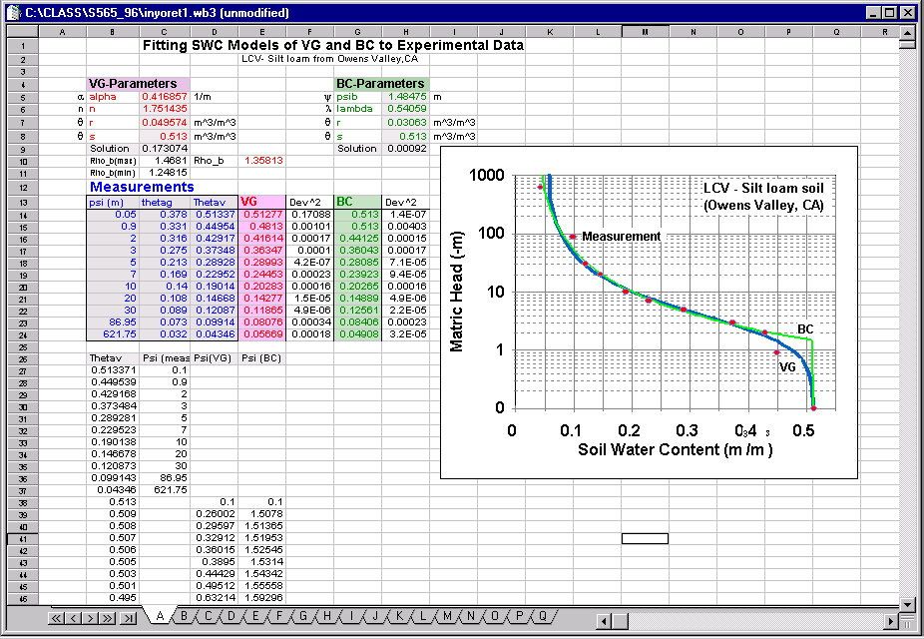

Fitting SWC models
We do it with:

Slide 27
Typical “van Genuchten” Model Parameters
Table1: Typical van Genuchten model parameters (α, n) including residual (θ_{r}) and saturated (θ_{s}) water contents compiled from the UNSODA database (Leij et al., 1996). N indicates the number of soils or samples of a given textural class from which the mean values are compiled.
Textural Class | N | θ_{r} [cm³/cm³] | θ_{s} [cm³/cm³] | α [1/cm] | n
Sand | 126 | 0.058 | 0.37 | 0.035 | 3.19
Loamy Sand | 51 | 0.074 | 0.39 | 0.035 | 2.39
Sandy Loam | 78 | 0.067 | 0.37 | 0.021 | 1.61
Loam | 61 | 0.083 | 0.46 | 0.025 | 1.31
Silt | 3 | 0.123 | 0.48 | 0.006 | 1.53
Silt Loam | 101 | 0.061 | 0.43 | 0.012 | 1.39
Sandy Clay Loam | 37 | 0.086 | 0.40 | 0.033 | 1.49
Clay Loam | 23 | 0.129 | 0.47 | 0.030 | 1.37
Silty Clay Loam | 20 | 0.098 | 0.55 | 0.027 | 1.41
Silty Clay | 12 | 0.163 | 0.47 | 0.023 | 1.39
Clay | 25 | 0.102 | 0.51 | 0.021 | 1.20

Slide 28
Databases for Soil Hydraulic Properties
Databases for hydraulic soil properties have been compiled by several agencies.
These data are good estimates for various soil textural classes and may be used as initial guesses for optimization of measured data.

Slide 29
Databases for Soil Hydraulic Properties
Graphical representation of various SWC curves contained in the UNSODA and NRCS databases.

Slide 30
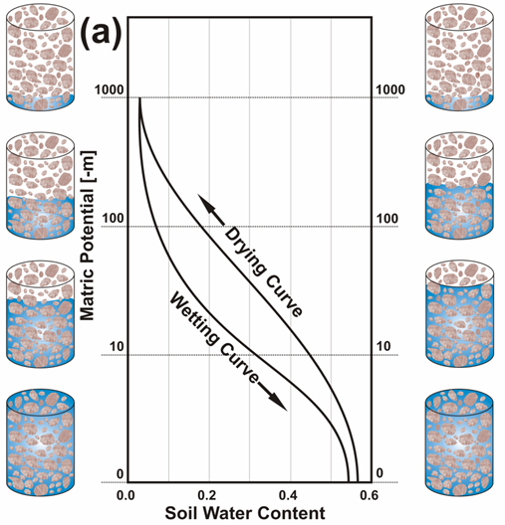
Hysteretic behavior of SWC
Soil Water Content and Matric Potential are not uniquely related and depend on the path of saturation or desaturation.
SWC can be either obtained by desaturation of an initially saturated sample by applying suction or pressure (DRYING CURVE), or by gradually wetting of an initially oven-dry sample (WETTING CURVE).
The two procedures often produce different SWC curves - the water content of the drying branch is typically higher than water content of a wetting curve at the same potential.
This phenomenon is known as HYSTERESIS

Slide 31
Hysteresis in SWC
The Hysteresis in the SWC relationship depends on several micro- and meso-scale phenomenon:
“INK BOTTLE” EFFECT resulting from non-uniformity in shape and size of interconnected pores:
Drainage is governed by the smaller pore radius, whereas wetting is governed by the larger radius. (Large pores drain first but fill up last) Different LIQUID-SOLID CONTACT ANGLES for advancing and receding liquid. ENTRAPPED AIR in newly wetted soil SWELLING AND SHRINKING of soil under wetting and drying
The role of individual factors remains unclear and is subject of ongoing research.

Slide 32
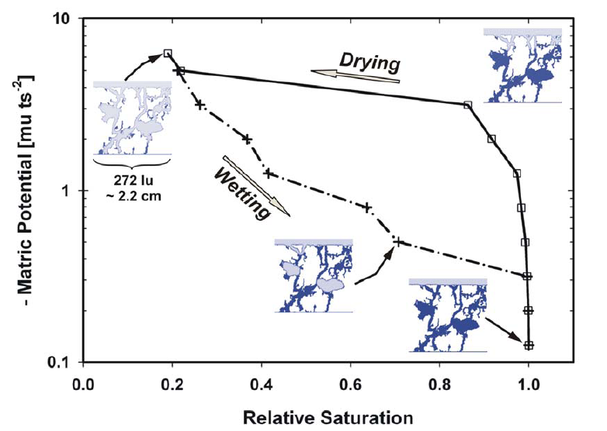
Hysteresis in SWC – meso-scale
Meso-scale manifestation of hysteresis through Lattice Boltzmann simulation of liquid configuration in complex pore spaces.
Entrapment of liquid in pore clusters

